Slide 1
Data Structures and Algorithms
Zero Pro Bootcamp Level-3
Myanmar IT Bootcamp

Slide 2
What is Data Structures
Data Structures are a specialized means of organizing and storing data in computers in such a way that we can perform operations on the stored data more efficiently. Data structures have a wide and diverse scope of usage across the fields of Computer Science and Software Engineering.

Slide 3
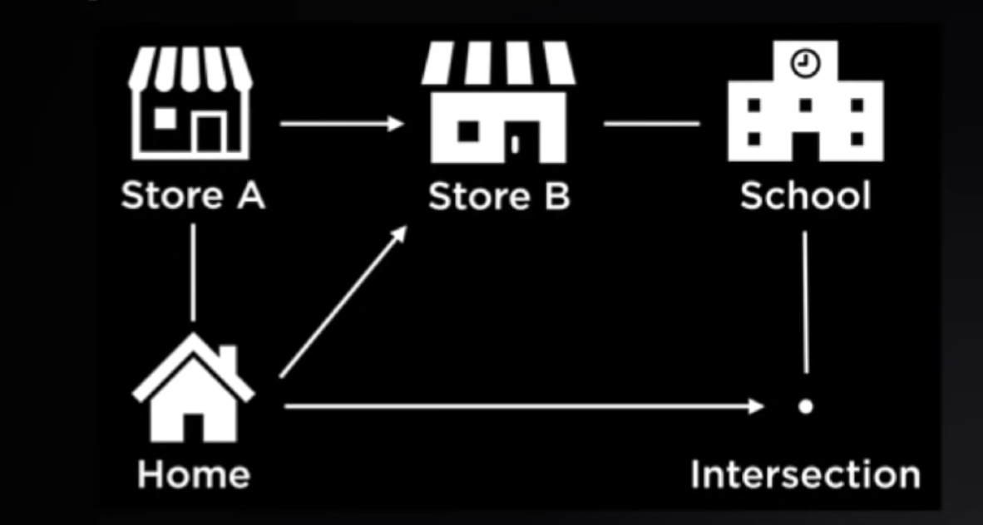
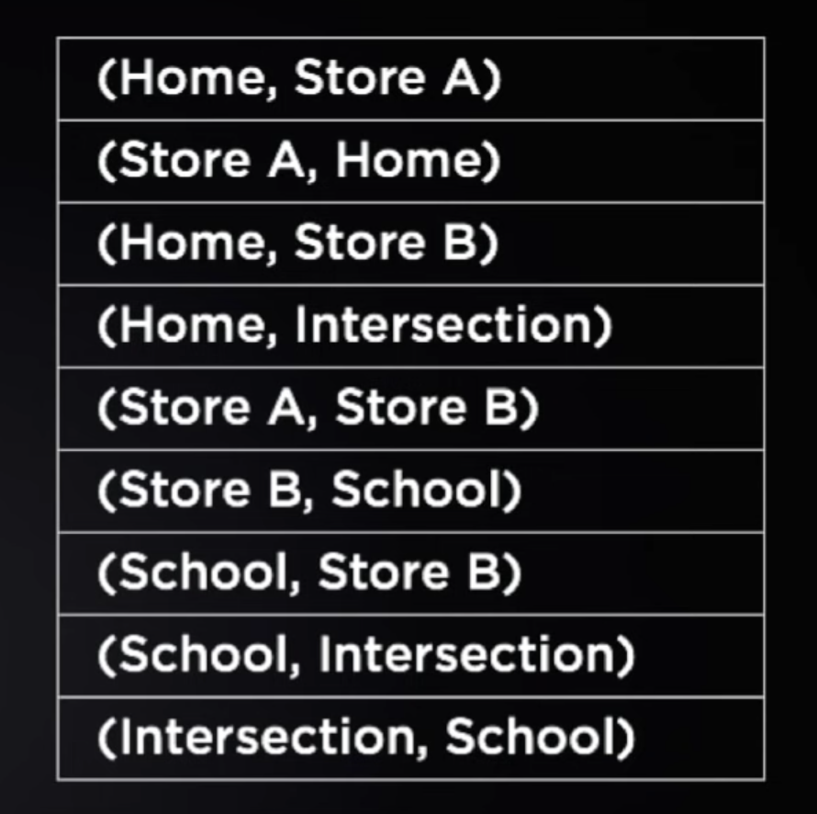
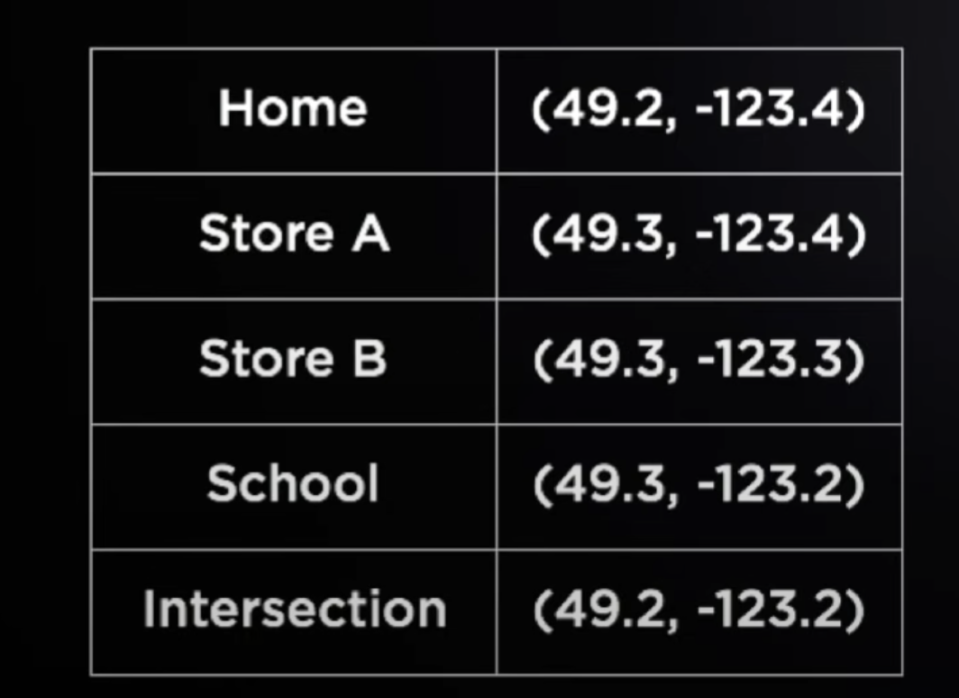
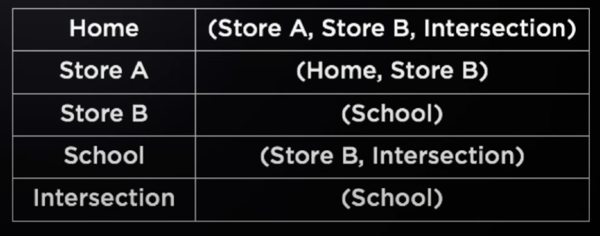

Slide 4
What is Algorithms
In computer programming terms, an algorithm is a set of well-defined instructions to solve a particular problem. It takes a set of input and produces a desired output.

Slide 5
An algorithm to add two numbers:
Take two number inputs
Add numbers using the + operator
Display the result
Find the shortest path from home to school
Find places you can go from home
From each of those places, find all paths
Keep distance of the track as you go
Repeat this process until you get to school
Compare the distance you have travelled
Find the shortest path

Slide 6
Qualities of Good Algorithms
Input and output should be defined precisely.
Each step in the algorithm should be clear and unambiguous.
Algorithms should be most effective among many different ways to solve a problem.
An algorithm shouldn't include computer code. Instead, the algorithm should be written in such a way that it can be used in different programming languages.

Slide 7
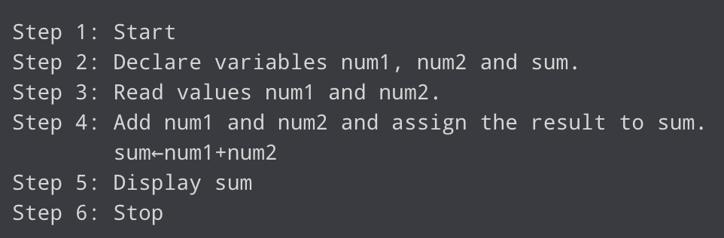
Add two numbers entered by the user

Slide 8
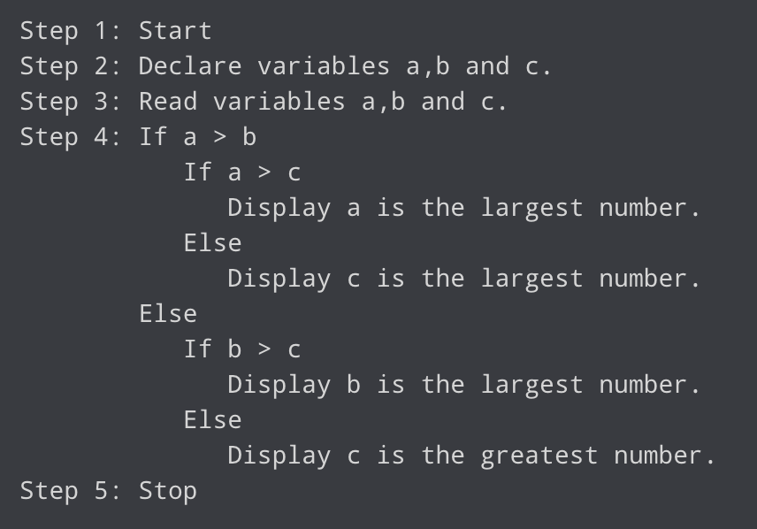
Find the largest number among three numbers

Slide 9
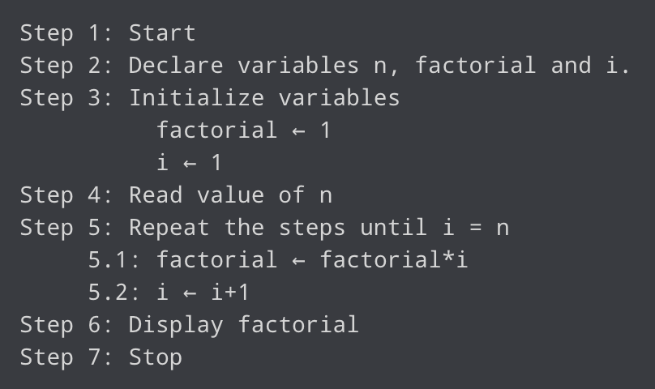
Find the factorial of a number

Slide 10
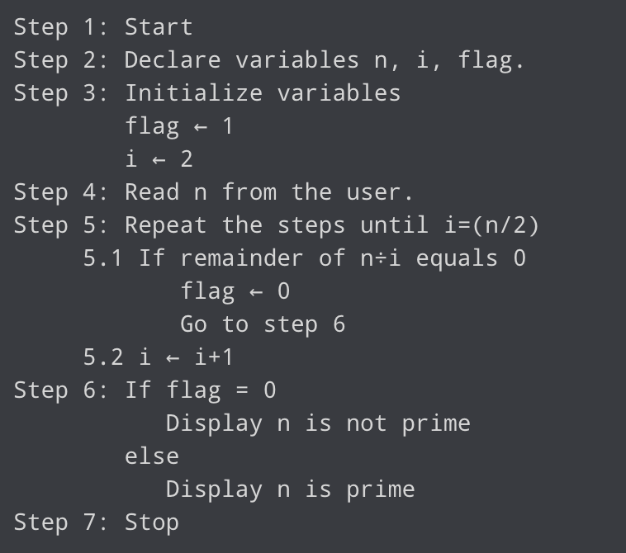
Check whether a number is prime or not

Slide 11
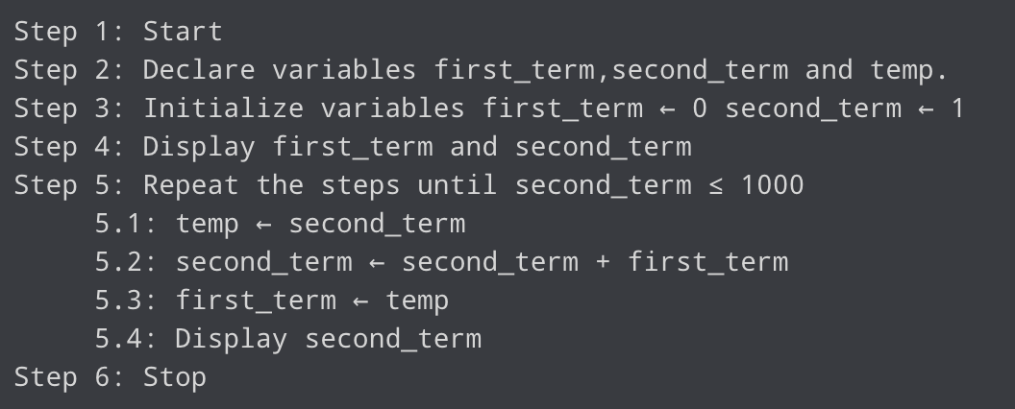
Find the Fibonacci series till the term less than 1000

Slide 12
Data Structure and Types
Data structure is a storage that is used to store and organize data. It is a way of arranging data on a computer so that it can be accessed and updated efficiently.
Depending on your requirement and project, it is important to choose the right data structure for your project.
Basically, data structures are divided into two categories:
Linear data structure
Non-linear data structure

Slide 13
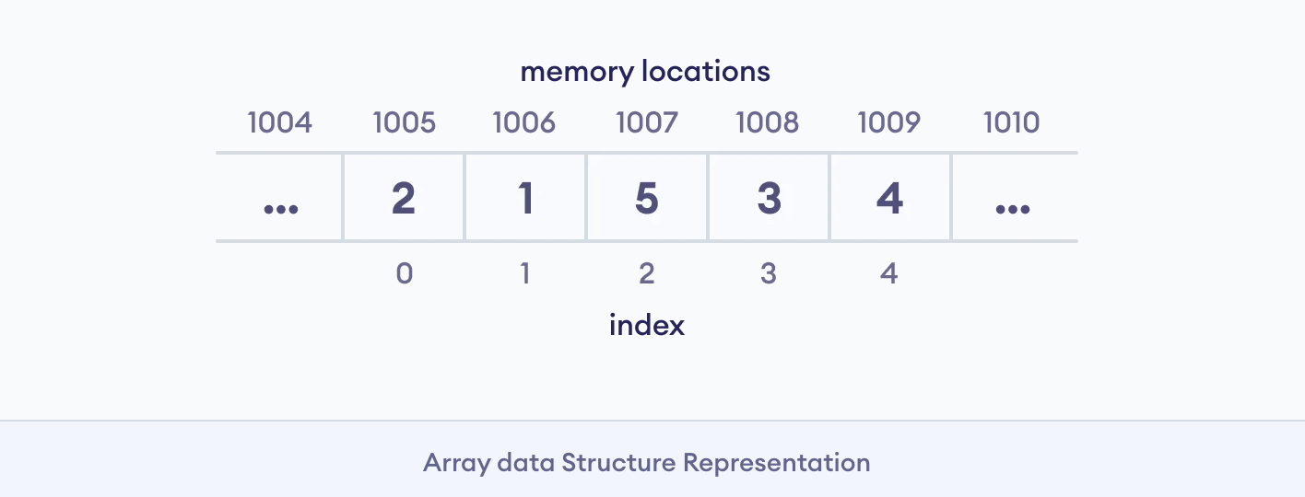
Linear data structures
the elements are arranged in sequence one after the other.
Since elements are arranged in particular order, they are easy to implement.
However, when the complexity of the program increases, the linear data structures might not be the best choice because of operational complexities.

Slide 14
1. Array Data Structure
In an array, elements in memory are arranged in continuous memory.

Slide 15
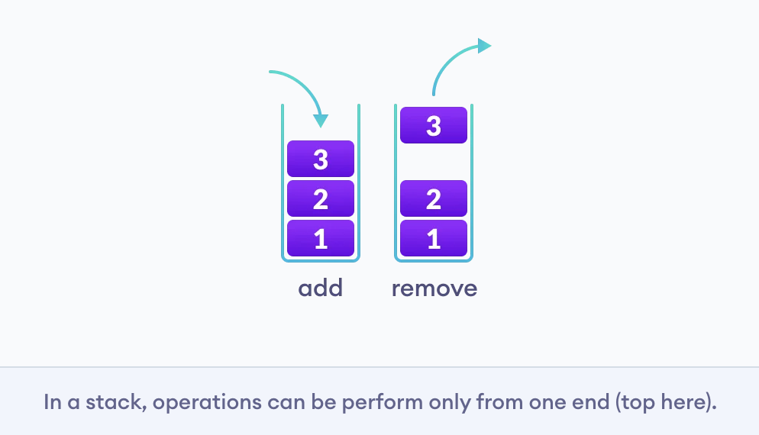
2. Stack Data Structure
In stack data structure, elements are stored in the LIFO principle. That is, the last element stored in a stack will be removed first.

Slide 16
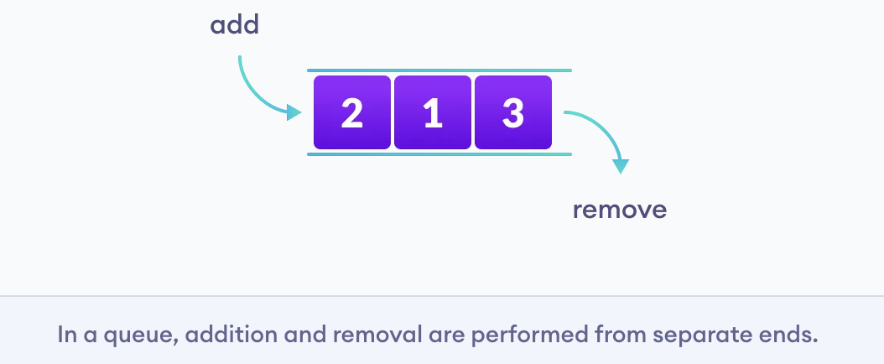
3. Queue Data Structure
Unlike stack, the queue data structure works in the FIFO principle where first element stored in the queue will be removed first.

Slide 17
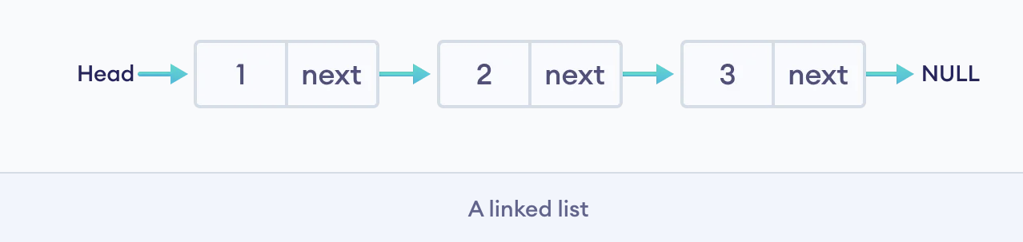
4. Linked List Data Structure
In linked list data structure, data elements are connected through a series of nodes. And, each node contains the data items and address to the next node.

Slide 18
Non linear data structures
Unlike linear data structures, elements in non-linear data structures are not in any sequence. Instead they are arranged in a hierarchical manner where one element will be connected to one or more elements. Non-linear data structures are further divided into graph and tree based data structures.

Slide 19
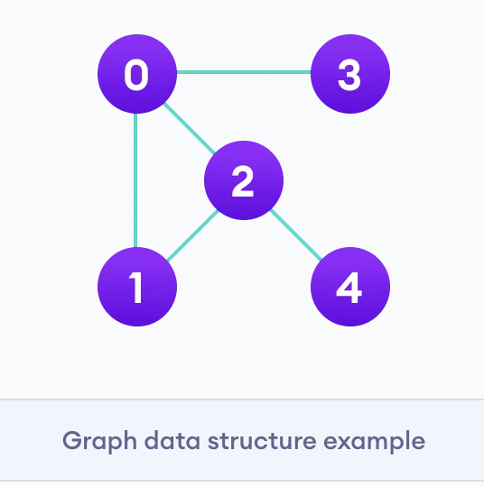
1. Graph Data Structure
In graph data structure, each node is called vertex and each vertex is connected to other vertices through edges.

Slide 20
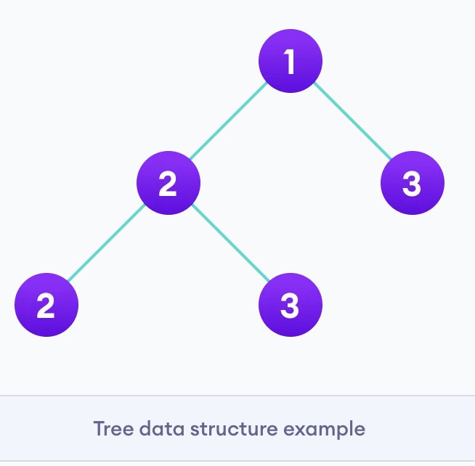
2. Trees Data Structure
Similar to a graph, a tree is also a collection of vertices and edges. However, in tree data structure, there can only be one edge between two vertices.

Slide 21
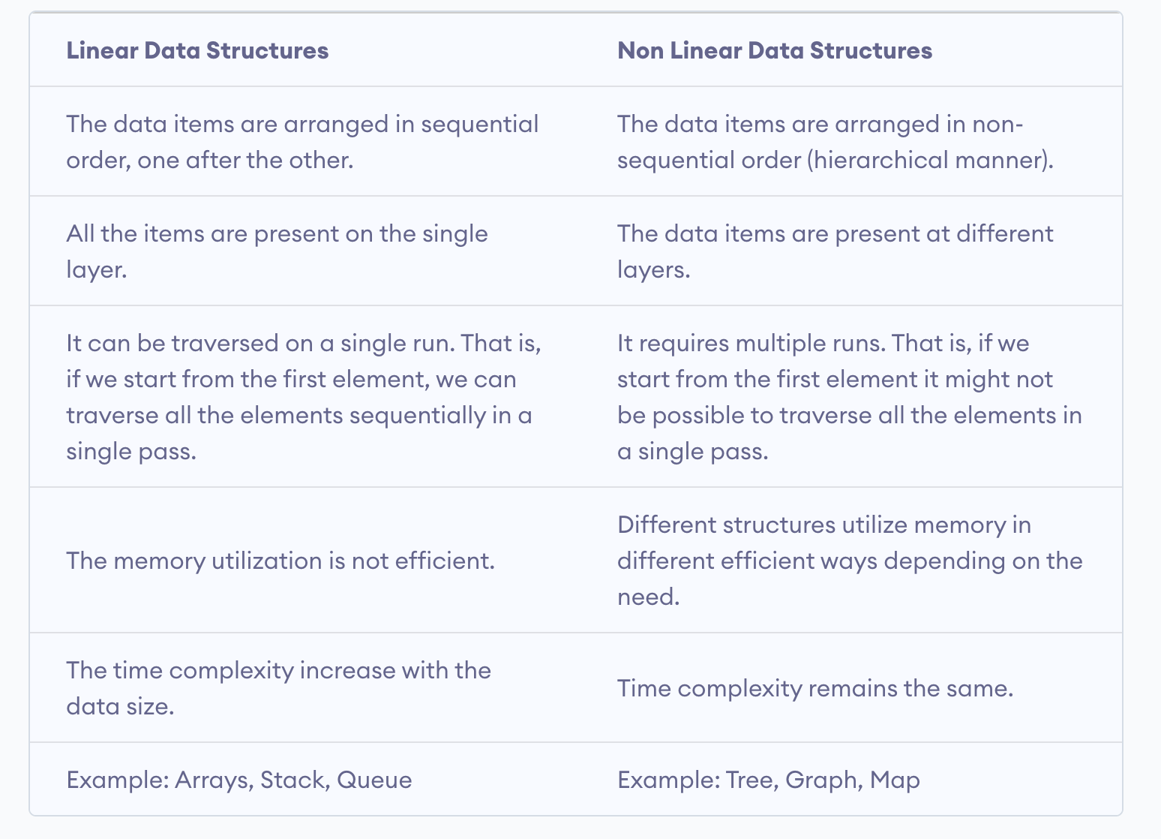
Linear Vs Non-linear Data Structures

Slide 22
Why Learn Data Structures and Algorithms
Programming is all about data structures and algorithms. Data structures are used to hold data while algorithms are used to solve the problem using that data. Data structures and algorithms (DSA) goes through solutions to standard problems in detail and gives you an insight into how efficient it is to use each one of them. It also teaches you the science of evaluating the efficiency of an algorithm. This enables you to choose the best of various choices.

Slide 23
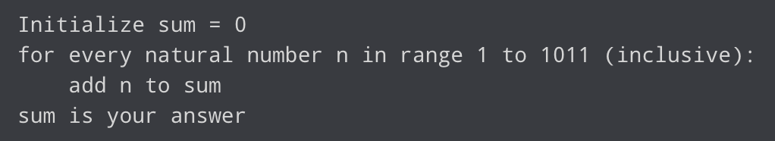
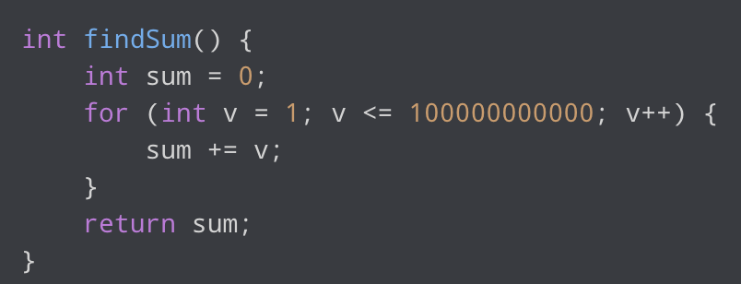
Make Your Code Scalable
to solve a simple problem of finding the sum of the first 10¹¹ natural numbers.

Slide 24
Two of the most valuable resources for a computer program are time and memory. The time taken by the computer to run code is:
Time to run code = number of instructions * time to execute each instruction
x = 1 + (10¹¹ + 1) + (10¹¹) + 1,
x = 2 * 10¹¹ + 3
y = 10⁸ instructions per seconds
Time taken to run code = x/y (greater than 16 minutes)
Sum = N * (N + 1) / 2
int sum(int N)
{
return N * (N + 1) / 2;
}

Slide 25
Our first solution to find the sum of first N natural numbers, it wasn't scalable. It's because it required linear growth in time with the linear growth in the size of the problem. Such algorithms are also known as linearly scalable algorithms.
Our second solution was very scalable and didn't require the use of any more time to solve a problem of larger size. These are known as constant-time algorithms.

Slide 26
Memory is expensive
Memory is not always available in abundance. While dealing with code/system which requires you to store or produce a lot of data, it is critical for your algorithm to save the usage of memory wherever possible.

Slide 27
If you don't know algorithms well, you won't be able to identify if you can optimize the code you are writing right now.
You are expected to know them in advance and apply them wherever possible and critical. We specifically talked about the scalability of algorithms.
A software system consists of many such algorithms. Optimizing any one of them leads to a better system. However, it's important to note that this is not the only way to make a system scalable.
For example, a technique known as distributed computing allows independent parts of a program to run to multiple machines together making it even more scalable.

Slide 28
Asymptotic Notations
Asymptotic notations are the mathematical notations used to describe the running time of an algorithm when the input tends towards a particular value or a limiting value.
There are mainly three asymptotic notations:
Big-O notation
Omega notation
Theta notation

Slide 29
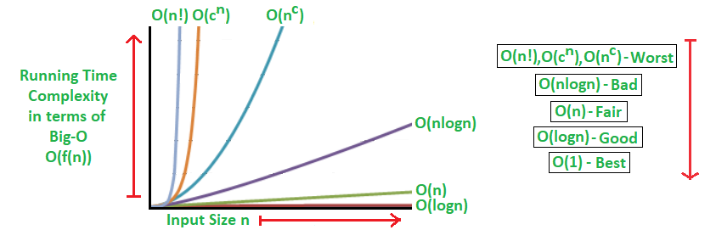
Big-O Notation (O-notation)
Big-O notation represents the upper bound of the running time of an algorithm. Thus, it gives the worst-case complexity of an algorithm.

Slide 30
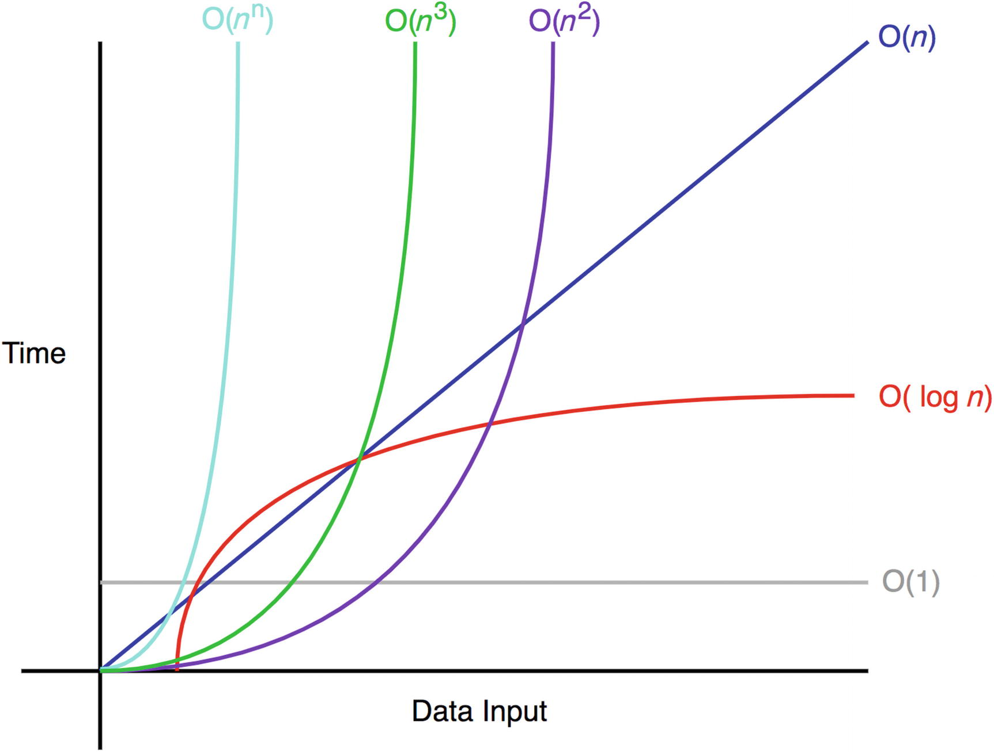
f(x) = 2
f(x) = 2x
f(x)=2x² + 1
f(x)=3x³+2x²+x+2

Slide 31
Omega Notation (Ω-notation)
Omega notation represents the lower bound of the running time of an algorithm. Thus, it provides the best case complexity of an algorithm.

Slide 32
Theta Notation (Θ-notation)
Theta notation encloses the function from above and below. Since it represents the upper and the lower bound of the running time of an algorithm, it is used for analyzing the average-case complexity of an algorithm.

Slide 33
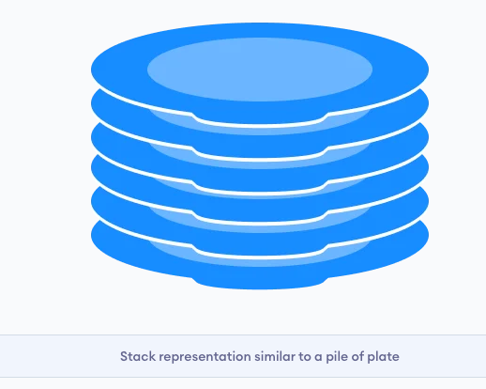
Stack Data Structure
A stack is a linear data structure that follows the principle of Last In First Out (LIFO). This means the last element inserted inside the stack is removed first. You can think of the stack data structure as the pile of plates on top of another.

Slide 34
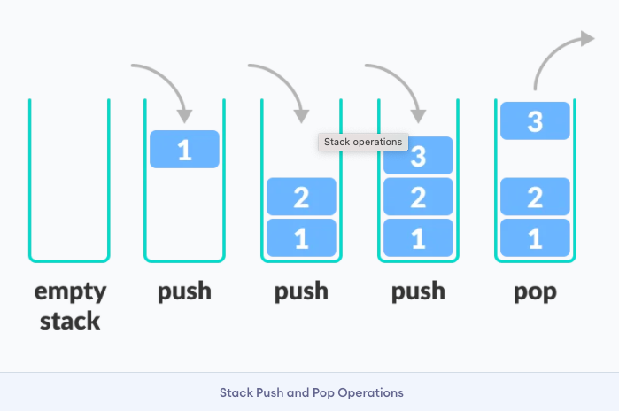
LIFO Principle of Stack
In programming terms, putting an item on top of the stack is called push and removing an item is called pop.

Slide 35
There are some basic operations that allow us to perform different actions on a stack.
Push: Add an element to the top of a stack
Pop: Remove an element from the top of a stack
IsEmpty: Check if the stack is empty
IsFull: Check if the stack is full
Peek: Get the value of the top element without removing it

Slide 36
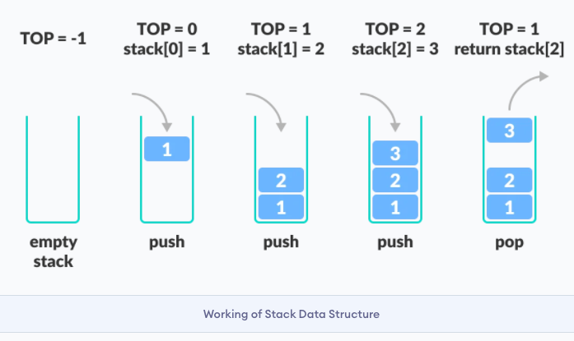

Slide 37
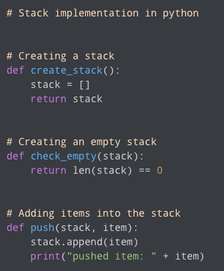
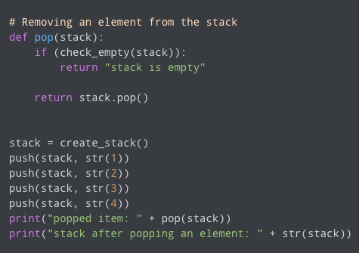

Slide 38
Stack Time Complexity
For the array-based implementation of a stack, the push and pop operations take constant time, i.e. O(1).

Slide 39
Applications of Stack Data Structure
Although stack is a simple data structure to implement, it is very powerful.
The most common uses of a stack are:
To reverse a word - Put all the letters in a stack and pop them out. Because of the LIFO order of stack, you will get the letters in reverse order.
In compilers - Compilers use the stack to calculate the value of expressions like 2 + 4 / 5 * (7 - 9) by converting the expression to prefix or postfix form.
In browsers - The back button in a browser saves all the URLs you have visited previously in a stack. Each time you visit a new page, it is added on top of the stack. When you press the back button, the current URL is removed from the stack, and the previous URL is accessed.

Slide 40
Queue Data Structure
A queue is a useful data structure in programming. It is similar to the ticket queue outside a cinema hall, where the first person entering the queue is the first person who gets the ticket.
Queue follows the First In First Out (FIFO) rule - the item that goes in first is the item that comes out first.

Slide 41
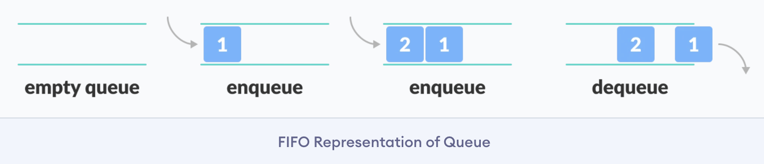

Slide 42
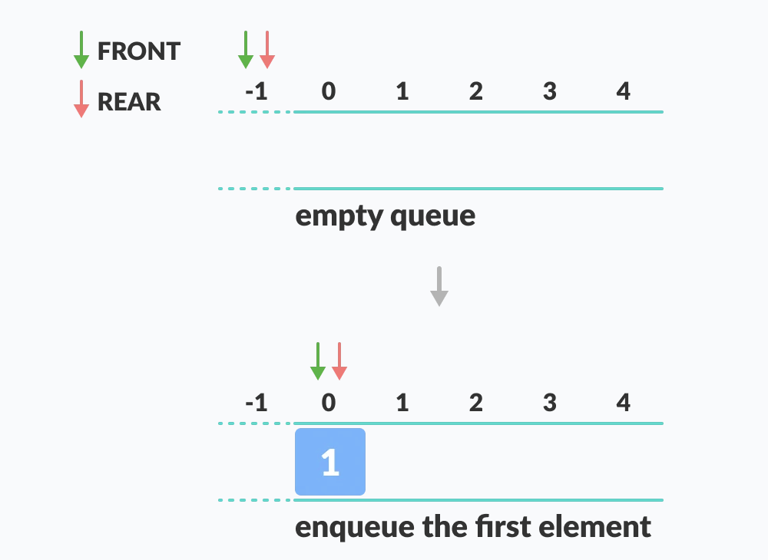

Slide 43
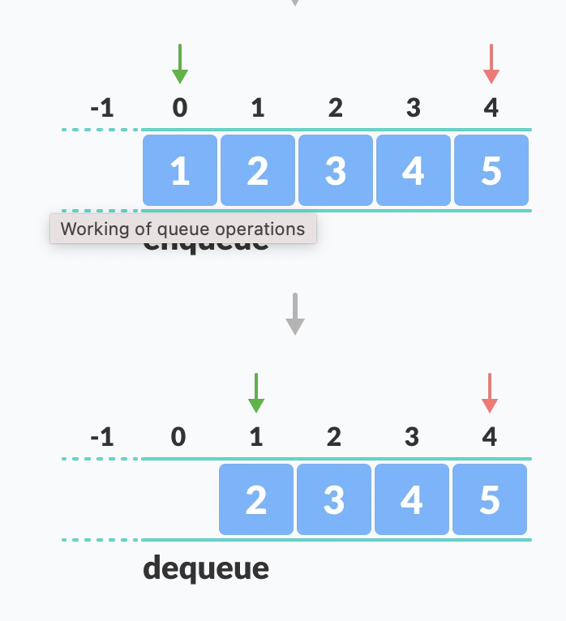

Slide 44
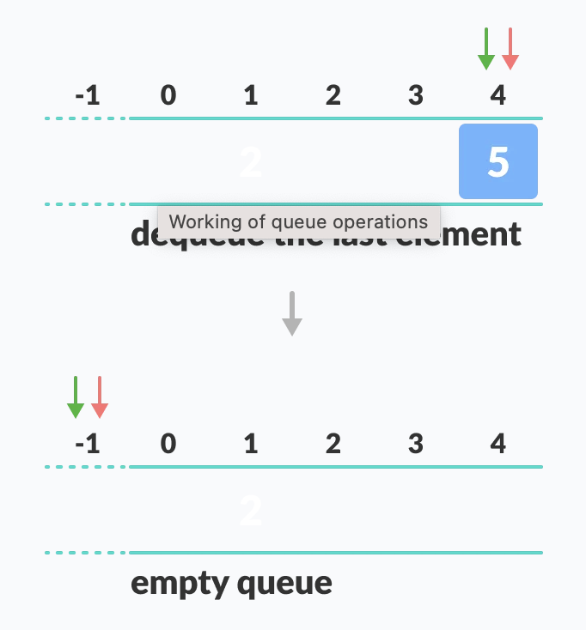

Slide 45
Basic Operations of Queue
A queue is an object (an abstract data structure - ADT) that allows the following operations:
Enqueue: Add an element to the end of the queue
Dequeue: Remove an element from the front of the queue
IsEmpty: Check if the queue is empty
IsFull: Check if the queue is full
Peek: Get the value of the front of the queue without removing it

Slide 46
Working of Queue
Queue operations work as follows:
two pointers FRONT and REAR
FRONT track the first element of the queue
REAR track the last element of the queue
initially, set value of FRONT and REAR to -1

Slide 47
Enqueue Operation
check if the queue is full
for the first element, set the value of FRONT to 0
increase the REAR index by 1
add the new element in the position pointed to by REAR

Slide 48
Dequeue Operation
check if the queue is empty
return the value pointed by FRONT
increase the FRONT index by 1
for the last element, reset the values of FRONT and REAR to -1

Slide 49
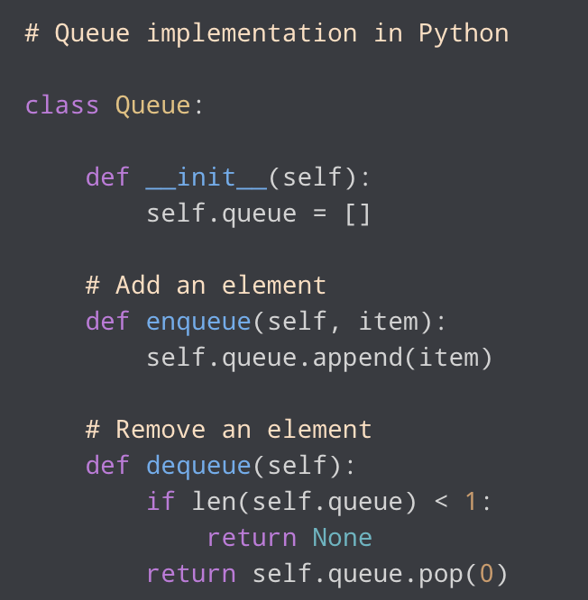
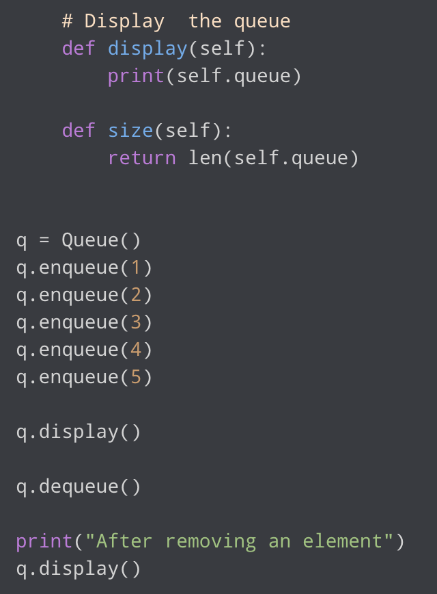

Slide 50
Limitations of Queue
As you can see in the image below, after a bit of enqueuing and dequeuing, the size of the queue has been reduced.
After REAR reaches the last index, if we can store extra elements in the empty spaces (0 and 1), we can make use of the empty spaces. This is implemented by a modified queue called the circular queue.
Complexity Analysis
The complexity of enqueue and dequeue operations in a queue using an array is O(1). If you use pop(N) in python code, then the complexity might be O(n) depending on the position of the item to be popped.

Slide 51
Applications of Queue
CPU scheduling, Disk Scheduling
When data is transferred asynchronously between two processes.The queue is used for synchronization. For example: IO Buffers, pipes, file IO, etc
Handling of interrupts in real-time systems.
Call Center phone systems use Queues to hold people calling them in order.

Slide 52
Types of Queues
four different types of queues:
Simple Queue
Circular Queue
Priority Queue
Double Ended Queue

Slide 53
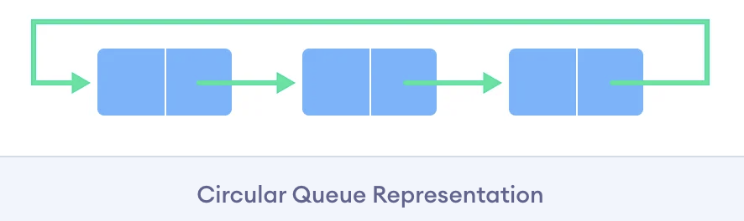
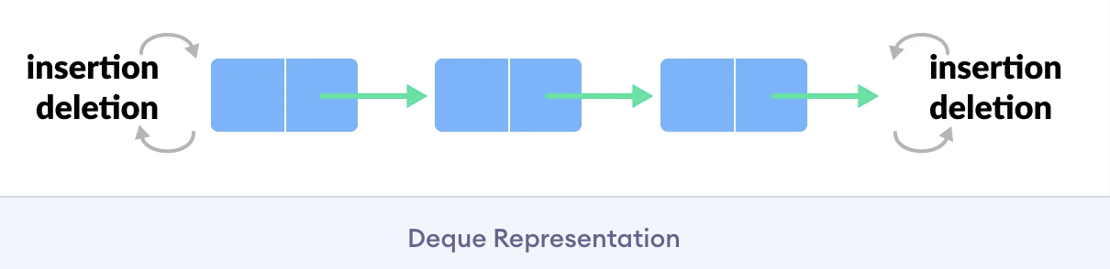
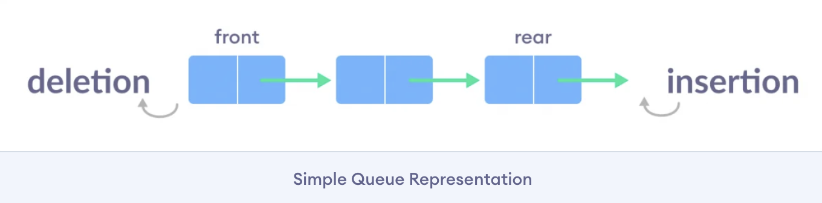

Slide 54
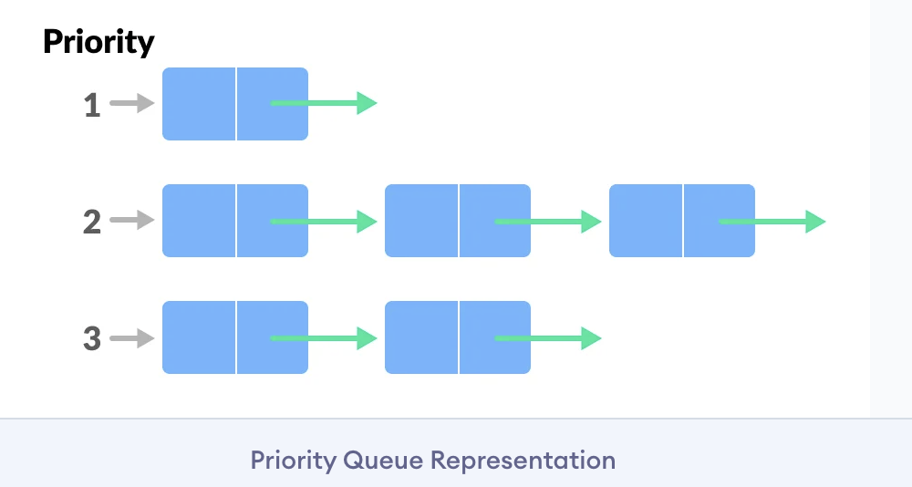

Slide 55
Simple Queue
In a simple queue, insertion takes place at the rear and removal occurs at the front. It strictly follows the FIFO (First in First out) rule.
Circular Queue
In a circular queue, the last element points to the first element making a circular link.
The main advantage of a circular queue over a simple queue is better memory utilization. If the last position is full and the first position is empty, we can insert an element in the first position. This action is not possible in a simple queue.
Priority Queue
A priority queue is a special type of queue in which each element is associated with a priority and is served according to its priority. If elements with the same priority occur, they are served according to their order in the queue.

Slide 56
Deque (Double Ended Queue)
In a double ended queue, insertion and removal of elements can be performed from either from the front or rear. Thus, it does not follow the FIFO (First In First Out) rule.
Circular Queue Data Structure
A circular queue is the extended version of a regular queue where the last element is connected to the first element. Thus forming a circle-like structure.
The circular queue solves the major limitation of the normal queue. In a normal queue, after a bit of insertion and deletion, there will be non-usable empty space.

Slide 57
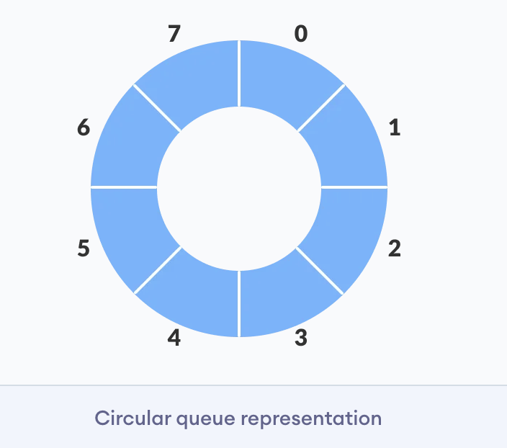
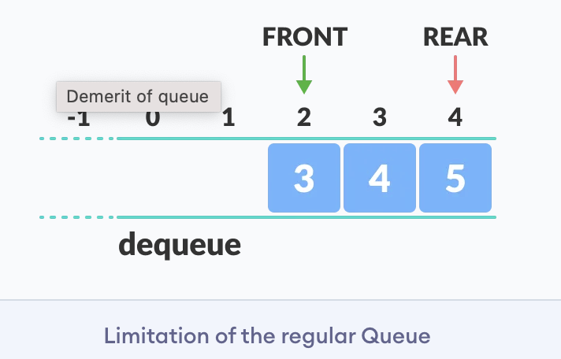

Slide 58
How Circular Queue Works
Circular Queue works by the process of circular increment i.e. when we try to increment the pointer and we reach the end of the queue, we start from the beginning of the queue.
Here, the circular increment is performed by modulo division with the queue size. That is,
if REAR + 1 == 5 (overflow!), REAR = (REAR + 1)%5 = 0 (start of queue)

Slide 59
Circular Queue Operations
The circular queue work as follows:
two pointers FRONT and REAR
FRONT track the first element of the queue
REAR track the last elements of the queue
initially, set value of FRONT and REAR to -1

Slide 60
1. Enqueue Operation
check if the queue is full
for the first element, set value of FRONT to 0
circularly increase the REAR index by 1 (i.e. if the rear reaches the end, next it would be at the start of the queue)
add the new element in the position pointed to by REAR
2. Dequeue Operation
check if the queue is empty
return the value pointed by FRONT
circularly increase the FRONT index by 1
for the last element, reset the values of FRONT and REAR to -1

Slide 61
However, the check for full queue has a new additional case:
Case 1: FRONT = 0 && REAR == SIZE - 1
Case 2: FRONT = REAR + 1

Slide 62
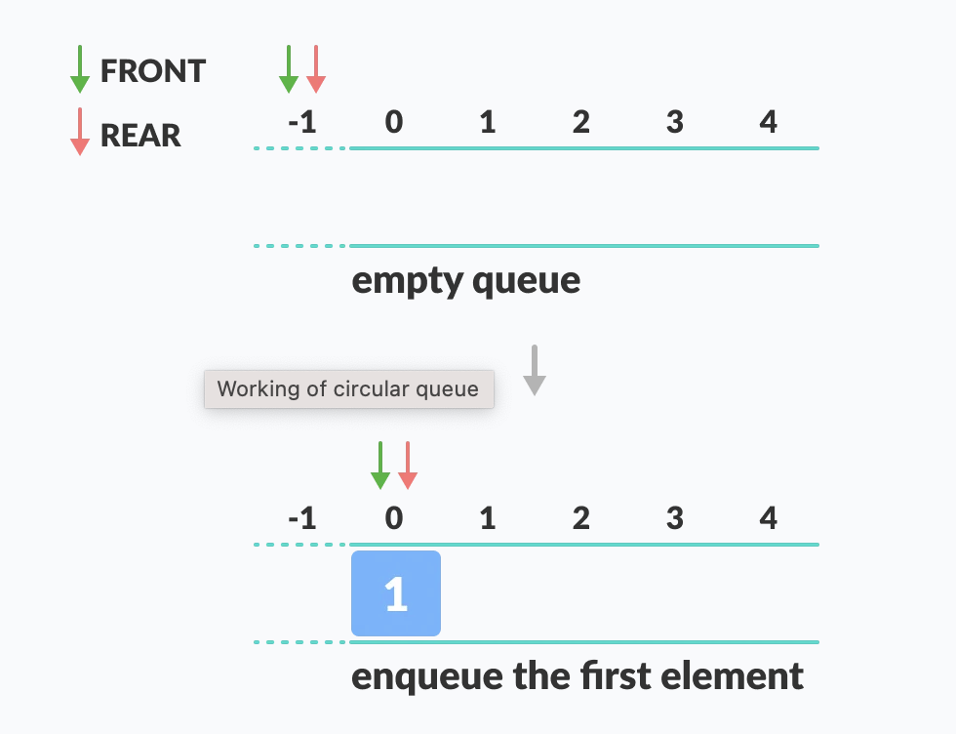

Slide 63
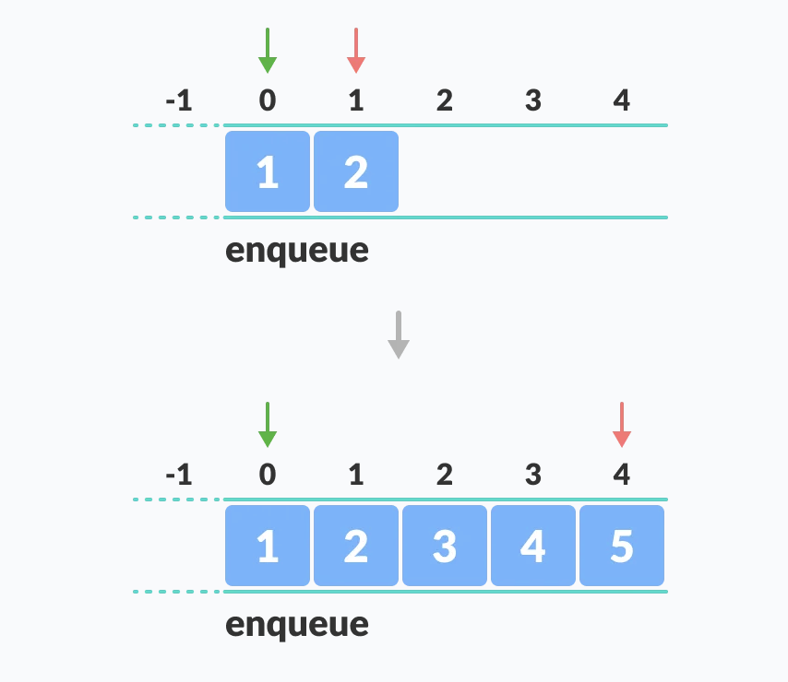

Slide 64
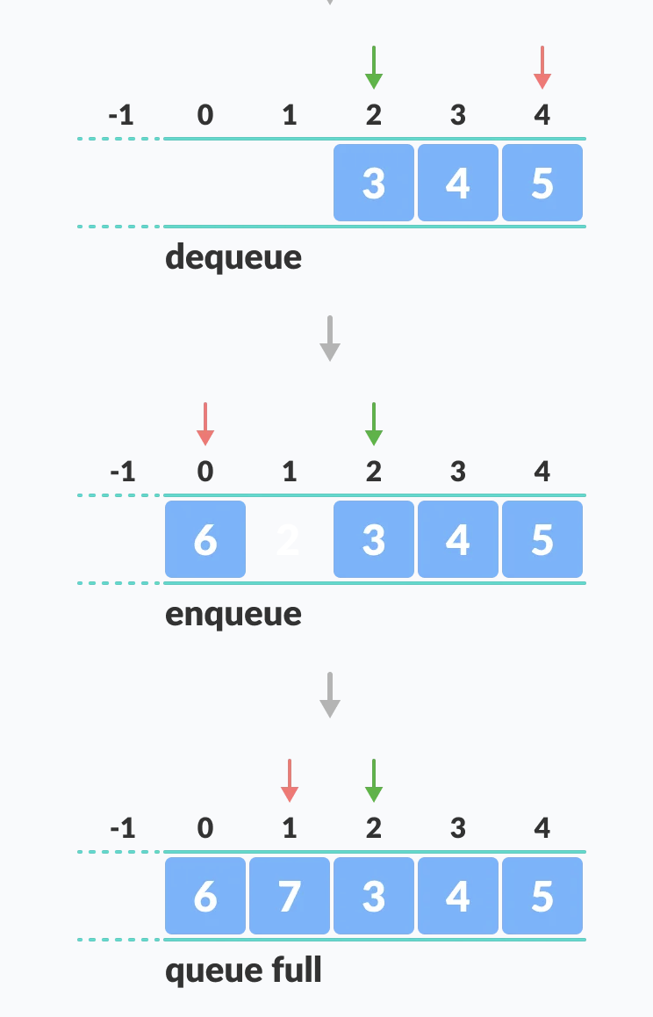

Slide 65
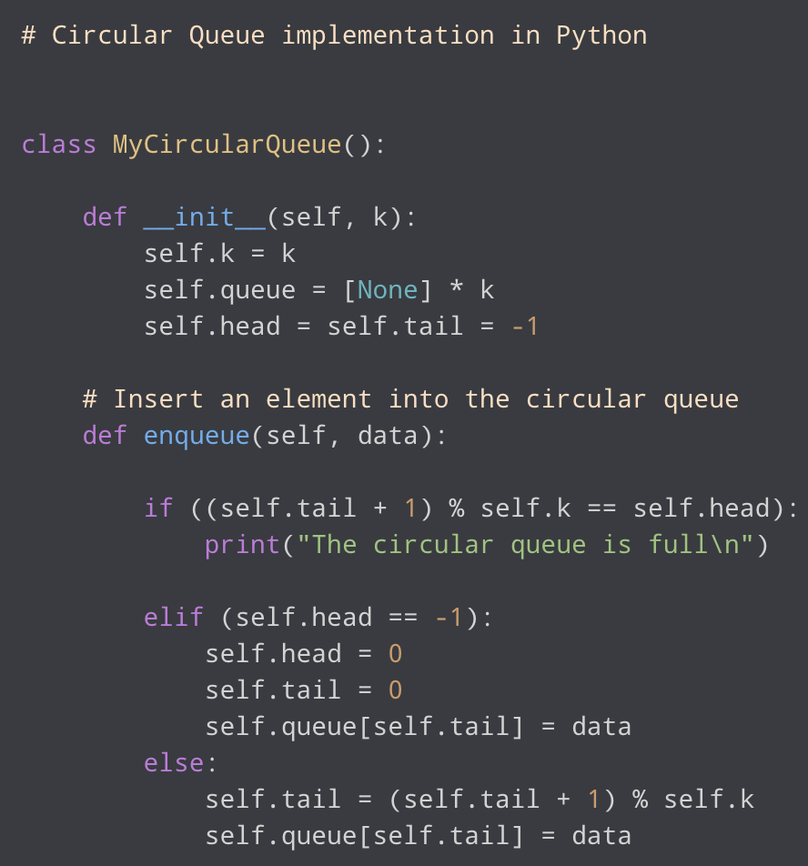
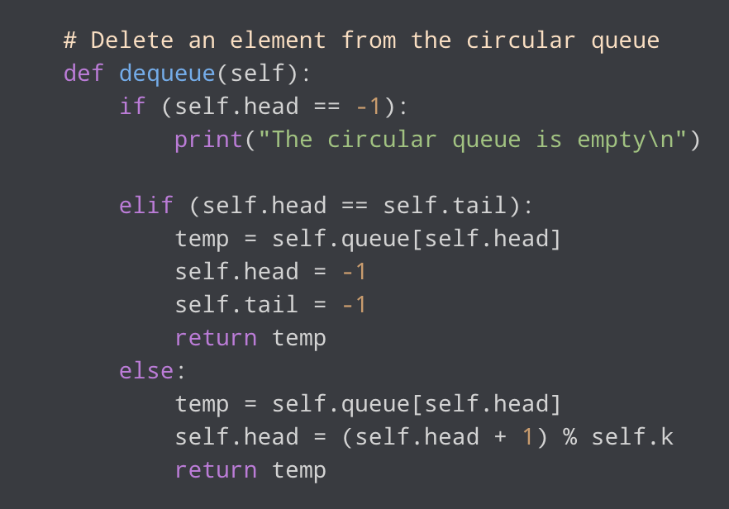

Slide 66
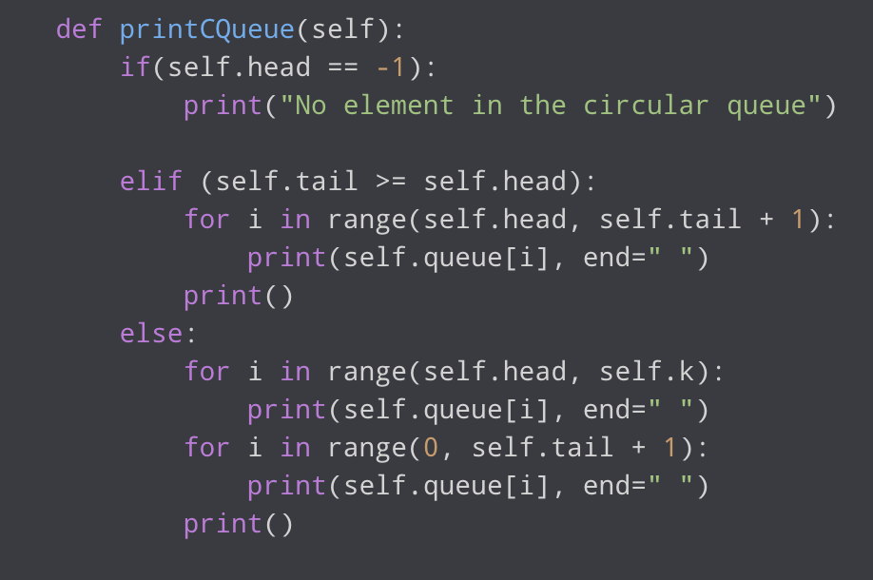

Slide 67
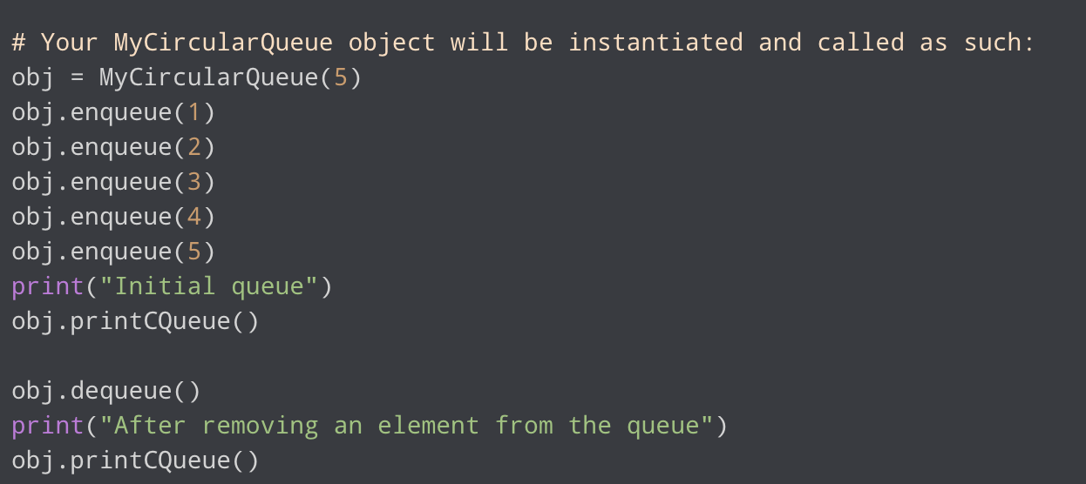

Slide 68
Circular Queue Complexity Analysis
The complexity of the enqueue and dequeue operations of a circular queue is O(1) for (array implementations).
Applications of Circular Queue
CPU scheduling
Memory management
Traffic Management

Slide 69
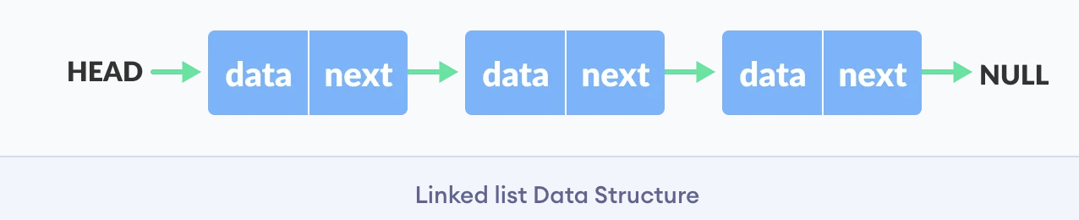
Linked list Data Structure
A linked list is a linear data structure that includes a series of connected nodes. Here, each node stores the data and the address of the next node.
Representation of Linked List
Let's see how each node of the linked list is represented. Each node consists:
A data item
An address of another node

Slide 70
Linked List Operations: Traverse, Insert and Delete
There are various linked list operations that allow us to perform different actions on linked lists. For example, the insertion operation adds a new element to the linked list.
Here's a list of basic linked list operations that we will cover in this article.
Traversal - access each element of the linked list
Insertion - adds a new element to the linked list
Deletion - removes the existing elements
Search - find a node in the linked list
Sort - sort the nodes of the linked list

Slide 71
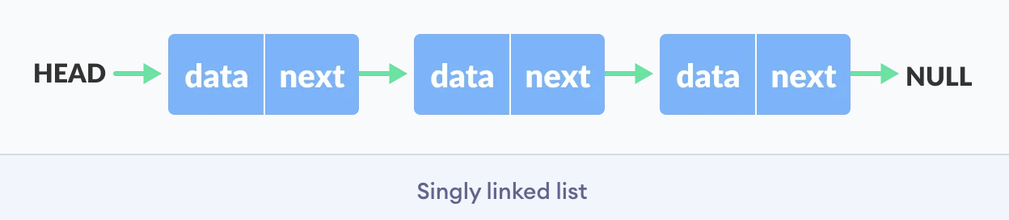
Things to Remember about Linked List
head points to the first node of the linked list
next pointer of the last node is NULL, so if the next current node is NULL, we have reached the end of the linked list.

Slide 72
Traverse a Linked List
Displaying the contents of a linked list is very simple. We keep moving the temp node to the next one and display its contents.
When temp is NULL, we know that we have reached the end of the linked list so we get out of the while loop.

Slide 73
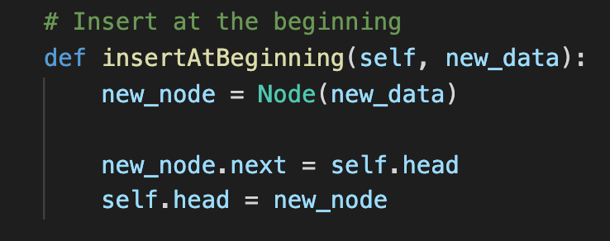
Insert Elements to a Linked List
You can add elements to either the beginning, middle or end of the linked list.
1. Insert at the beginning
Allocate memory for new node
Store data
Change next of new node to point to head
Change head to point to recently created node

Slide 74
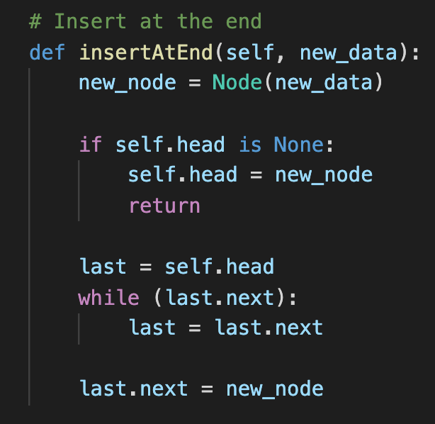
2. Insert at the End
Allocate memory for new node
Store data
Traverse to last node
Change next of last node to recently created node

Slide 75
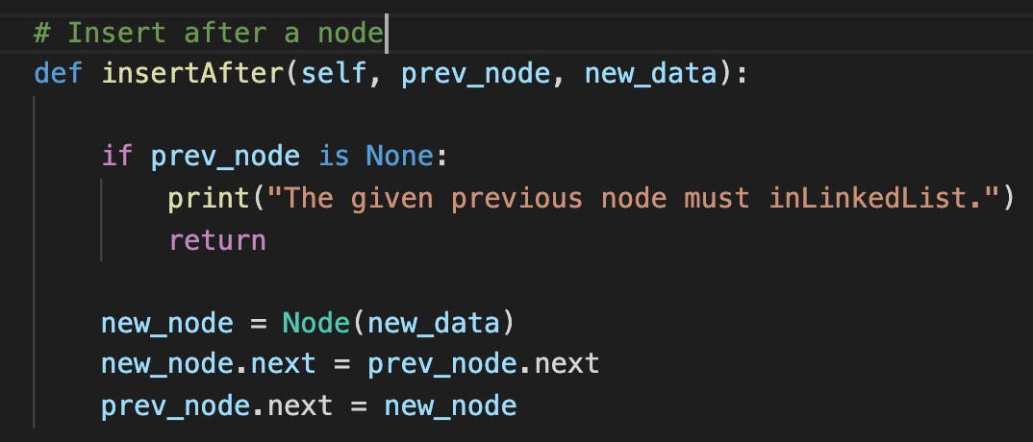
3. Insert at the Middle
Allocate memory and store data for new node
Traverse to node just before the required position of new node
Change next pointers to include new node in between

Slide 76
Delete from a Linked List
You can delete either from the beginning, end or from a particular position.
1. Delete from beginning
Point head to the second node
2. Delete from end
Traverse to second last element
Change its next pointer to null
3. Delete from middle
Traverse to element before the element to be deleted
Change next pointers to exclude the node from the chain

Slide 77
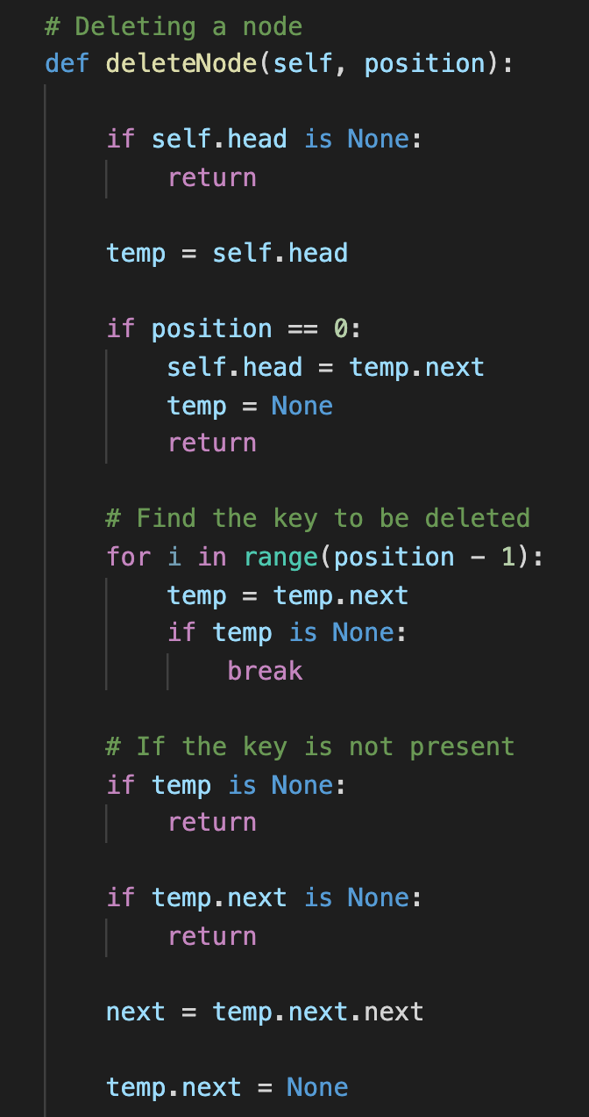

Slide 78
Search an Element on a Linked List
You can search an element on a linked list using a loop using the following steps. We are finding item on a linked list.
Make head as the current node.
Run a loop until the current node is NULL because the last element points to NULL.
In each iteration, check if the key of the node is equal to item. If it the key matches the item, return true otherwise return false.

Slide 79


Slide 80
Sort Elements of a Linked List
We will use a simple sorting algorithm, Bubble Sort, to sort the elements of a linked list in ascending order below.
Make the head as the current node and create another node index for later use.
If head is null, return.
Else, run a loop till the last node (i.e. NULL).
In each iteration, follow the following step 5-6.
Store the next node of current in index.
Check if the data of the current node is greater than the next node. If it is greater, swap current and index.

Slide 81


Slide 82


Slide 83
Types of Linked List - Singly linked, doubly linked and circular
There are three common types of Linked List.
Singly Linked List
Doubly Linked List
Circular Linked List

Slide 84
Singly Linked List
It is the most common. Each node has data and a pointer to the next node.
Doubly Linked List
We add a pointer to the previous node in a doubly-linked list. Thus, we can go in either direction: forward or backward.
Circular Linked List
A circular linked list is a variation of a linked list in which the last element is linked to the first element. This forms a circular loop.
A circular linked list can be either singly linked or doubly linked.
for singly linked list, next pointer of last item points to the first item
In the doubly linked list, prev pointer of the first item points to the last item as well.

Slide 85



Slide 86

Hash Table
The Hash table data structure stores elements in key-value pairs where
Key- unique integer that is used for indexing the values
Value - data that are associated with keys.

Slide 87

Hashing (Hash Function)
In a hash table, a new index is processed using the keys. And, the element corresponding to that key is stored in the index. This process is called hashing.
Let k be a key and h(x) be a hash function.
Here, h(k) will give us a new index to store the element linked with k.

Slide 88
Heap Data Structure
Heap data structure is a complete binary tree that satisfies the heap property, where any given node is
always greater than its child node/s and the key of the root node is the largest among all other nodes. This property is also called max heap property.
always smaller than the child node/s and the key of the root node is the smallest among all other nodes. This property is also called min heap property.

Slide 89
Complete Binary Tree
A complete binary tree is a binary tree in which all the levels are completely filled except possibly the lowest one, which is filled from the left.
A complete binary tree is just like a full binary tree, but with two major differences
All the leaf elements must lean towards the left.
The last leaf element might not have a right sibling i.e. a complete binary tree doesn't have to be a full binary tree.

Slide 90


Slide 91




Slide 92



Slide 93



Slide 94
Heap Operations
Some of the important operations performed on a heap are described below along with their algorithms.
Heapify
Heapify is the process of creating a heap data structure from a binary tree. It is used to create a Min-Heap or a Max-Heap.
Let the input array be
Create a complete binary tree from the array
Start from the first index of non-leaf node whose index is given by n/2 - 1.
Set current element i as largest.
The index of left child is given by 2i + 1 and the right child is given by 2i + 2. If leftChild is greater than currentElement (i.e. element at ith index), set leftChildIndex as largest. If rightChild is greater than element in largest, set rightChildIndex as largest.
Swap largest with currentElement
Repeat steps 3-7 until the subtrees are also heapified.

Slide 95





Slide 96
Insert Element into Heap
Insert the new element at the end of the tree.
Heapify the tree.
Delete Element from Heap
Select the element to be deleted.
Swap it with the last element.
Remove the last element.
Heapify the tree.

Slide 97



Slide 98





Slide 99


Slide 100


Slide 101


Slide 102


Slide 103
Peek (Find max/min)
Peek operation returns the maximum element from Max Heap or minimum element from Min Heap without deleting the node.
Extract-Max/Min
Extract-Max returns the node with maximum value after removing it from a Max Heap whereas Extract-Min returns the node with minimum after removing it from Min Heap.

Slide 104
Heap Data Structure Applications
Heap is used while implementing a priority queue.
Dijkstra's Algorithm
Heap Sort

Slide 105
Tree Data Structure
A tree is a nonlinear hierarchical data structure that consists of nodes connected by edges.
Why Tree Data Structure?
Other data structures such as arrays, linked list, stack, and queue are linear data structures that store data sequentially. In order to perform any operation in a linear data structure, the time complexity increases with the increase in the data size. But, it is not acceptable in today's computational world.
Different tree data structures allow quicker and easier access to the data as it is a non-linear data structure.

Slide 106



Slide 107
Tree Terminologies
Node
A node is an entity that contains a key or value and pointers to its child nodes.
The last nodes of each path are called leaf nodes or external nodes that do not contain a link/pointer to child nodes.
The node having at least a child node is called an internal node.
Edge
It is the link between any two nodes.

Slide 108



Slide 109
Root
It is the topmost node of a tree.
Height of a Node
The height of a node is the number of edges from the node to the deepest leaf (ie. the longest path from the node to a leaf node).
Depth of a Node
The depth of a node is the number of edges from the root to the node.
Height of a Tree
The height of a Tree is the height of the root node or the depth of the deepest node.

Slide 110

Degree of a Node
The degree of a node is the total number of branches of that node.
Forest
A collection of disjoint trees is called a forest.
You can create a forest by cutting the root of a tree.

Slide 111
Types of Tree
Binary Tree
Binary Search Tree
AVL Tree
B-Tree

Slide 112

Binary Tree
A binary tree is a tree data structure in which each parent node can have at most two children. Each node of a binary tree consists of three items:
data item
address of left child
address of right child

Slide 113


Slide 114
Binary Tree Applications
For easy and quick access to data
In router algorithms
To implement heap data structure
Syntax tree

Slide 115
Tree Applications
Binary Search Trees(BSTs) are used to quickly check whether an element is present in a set or not.
Heap is a kind of tree that is used for heap sort.
A modified version of a tree called Tries is used in modern routers to store routing information.
Most popular databases use B-Trees and T-Trees, which are variants of the tree structure we learned above to store their data
Compilers use a syntax tree to validate the syntax of every program you write.

Slide 116



Slide 117
Tree Traversal - inorder, preorder and postorder
Traversing a tree means visiting every node in the tree. You might, for instance, want to add all the values in the tree or find the largest one. For all these operations, you will need to visit each node of the tree.
Linear data structures like arrays, stacks, queues, and linked list have only one way to read the data. But a hierarchical data structure like a tree can be traversed in different ways.

Slide 118



Slide 119
Let's think about how we can read the elements of the tree in the image shown above.
Starting from top, Left to right
1 -> 12 -> 5 -> 6 -> 9
Starting from bottom, Left to right
5 -> 6 -> 12 -> 9 -> 1
Although this process is somewhat easy, it doesn't respect the hierarchy of the tree, only the depth of the nodes.

Slide 120
Depending on the order in which we do this, there can be three types of traversal.
Inorder traversal
First, visit all the nodes in the left subtree
Then the root node
Visit all the nodes in the right subtree
Preorder traversal
Visit root node
Visit all the nodes in the left subtree
Visit all the nodes in the right subtree

Slide 121
Postorder traversal
Visit all the nodes in the left subtree
Visit all the nodes in the right subtree
Visit the root node
We traverse the left subtree first. We also need to remember to visit the root node and the right subtree when this tree is done.

Slide 122
Binary Search Tree(BST)
Binary search tree is a data structure that quickly allows us to maintain a sorted list of numbers.
It is called a binary tree because each tree node has a maximum of two children.
It is called a search tree because it can be used to search for the presence of a number in O(log(n)) time.
The properties that separate a binary search tree from a regular binary tree is
All nodes of left subtree are less than the root node
All nodes of right subtree are more than the root node
Both subtrees of each node are also BSTs i.e. they have the above two properties

Slide 123
Search Operation
The algorithm depends on the property of BST that if each left subtree has values below root and each right subtree has values above the root.
If the value is below the root, we can say for sure that the value is not in the right subtree; we need to only search in the left subtree and if the value is above the root, we can say for sure that the value is not in the left subtree; we need to only search in the right subtree.

Slide 124


Slide 125
Insert Operation
Inserting a value in the correct position is similar to searching because we try to maintain the rule that the left subtree is lesser than root and the right subtree is larger than root.
We keep going to either right subtree or left subtree depending on the value and when we reach a point left or right subtree is null, we put the new node there.

Slide 126


Slide 127
Deletion Operation
There are three cases for deleting a node from a binary search tree.
Case I
In the first case, the node to be deleted is the leaf node. In such a case, simply delete the node from the tree.
Case II
In the second case, the node to be deleted lies has a single child node. In such a case follow the steps below:
Replace that node with its child node.
Remove the child node from its original position.

Slide 128
Case III
In the third case, the node to be deleted has two children. In such a case follow the steps below:
Get the inorder successor of that node.
Replace the node with the inorder successor.
Remove the inorder successor from its original position.
Binary Search Tree Applications
In multilevel indexing in the database
For dynamic sorting
For managing virtual memory areas in Unix kernel

Slide 129
Bubble Sort
Bubble sort is a sorting algorithm that compares two adjacent elements and swaps them until they are not in the intended order.
Just like the movement of air bubbles in the water that rise up to the surface, each element of the array move to the end in each iteration. Therefore, it is called a bubble sort.

Slide 130


Slide 131


Slide 132


Slide 133


Slide 134
Working of Bubble Sort
Suppose we are trying to sort the elements in ascending order.
1. First Iteration (Compare and Swap)
Starting from the first index, compare the first and the second elements.
If the first element is greater than the second element, they are swapped.
Now, compare the second and the third elements. Swap them if they are not in order.
The above process goes on until the last element.

Slide 135
2. Remaining Iteration
The same process goes on for the remaining iterations.
After each iteration, the largest element among the unsorted elements is placed at the end.
In each iteration, the comparison takes place up to the last unsorted element.
The array is sorted when all the unsorted elements are placed at their correct positions.

Slide 136
Bubble Sort Applications
Bubble sort is used if
complexity does not matter
short and simple code is preferred

Slide 137
Selection Sort Algorithm
Selection sort is a sorting algorithm that selects the smallest element from an unsorted list in each iteration and places that element at the beginning of the unsorted list.
Working of Selection Sort
Set the first element as minimum.
Compare minimum with the second element. If the second element is smaller than minimum, assign the second element as minimum.

Slide 138




Slide 139



Slide 140



Slide 141


Slide 142
Compare minimum with the third element. Again, if the third element is smaller, then assign minimum to the third element otherwise do nothing. The process goes on until the last element.
After each iteration, minimum is placed in the front of the unsorted list.
For each iteration, indexing starts from the first unsorted element. Step 1 to 3 are repeated until all the elements are placed at their correct positions.

Slide 143
Selection Sort Applications
The selection sort is used when
a small list is to be sorted
cost of swapping does not matter
checking of all the elements is compulsory
cost of writing to a memory matters like in flash memory (number of writes/swaps is O(n) as compared to O(n2) of bubble sort)

Slide 144

Linear Search
Linear search is a sequential searching algorithm where we start from one end and check every element of the list until the desired element is found. It is the simplest searching algorithm.

Slide 145
How Linear Search Works?
The following steps are followed to search for an element k = 1 in the list below.
Start from the first element, compare k with each element x
If x == k, return the index.
Else, return not found.

Slide 146



Slide 147
Linear Search Applications
For searching operations in smaller arrays (<100 items).

Slide 148
Binary Search
Binary Search is a searching algorithm for finding an element's position in a sorted array.
In this approach, the element is always searched in the middle of a portion of an array.

Slide 149
Binary Search Working
Binary Search Algorithm can be implemented in two ways which are discussed below.
Iterative Method
Recursive Method
The recursive method follows the divide and conquer approach.

Slide 150





Slide 151
The array in which searching is to be performed is:
Let x = 4 be the element to be searched.
Set two pointers low and high at the lowest and the highest positions respectively.
Find the middle element mid of the array ie. arr[(low + high)/2] = 6.
If x == mid, then return mid.Else, compare the element to be searched with m.
If x > mid, compare x with the middle element of the elements on the right side of mid. This is done by setting low to low = mid + 1.
6. Else, compare x with the middle element of the elements on the left side of mid. This is done by setting high to high = mid - 1.
7.Repeat steps 3 to 6 until low meets high.
8. x = 4 is found.

Slide 152


Slide 153


Slide 154
Binary Search Applications
In libraries of Java, .Net, C++ STL
While debugging, the binary search is used to pinpoint the place where the error happens.

